Slide 1
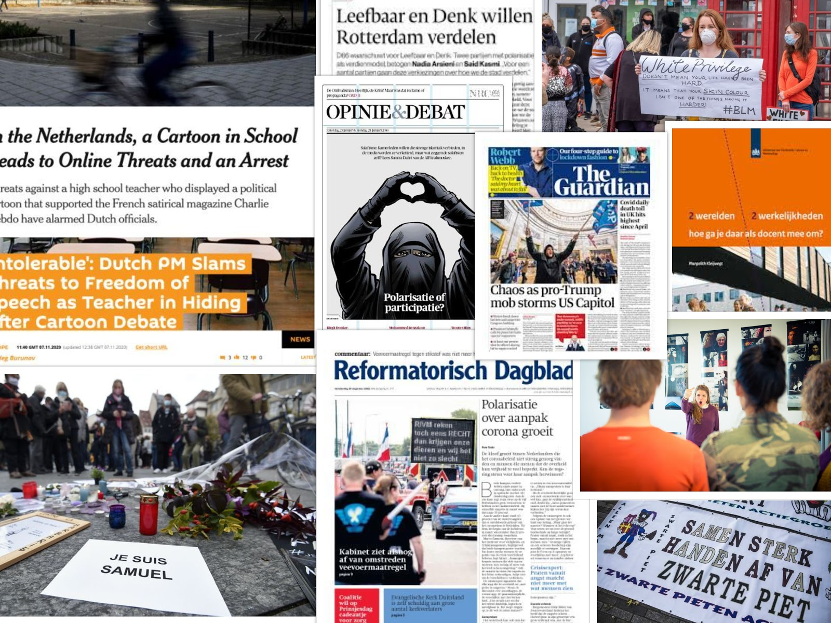
CONFLICT & DIALOGUE
Transforming destructive polarizations
into constructive dialogues in MBO settings
Pre-Proposal form NWA-ORC 2020/21

Slide 2
Dialogue as an Antidote to Polarization?
NWO/ORC (Nationale Wetenschapsagenda) proposal
To what extent does dialoguing minimize (deconstructive forms of) polarization?
Together with social scientists and communication scientists (virtual reality)
Grube: dialogue

Slide 3
Dialogue
In NL many dialogue initiatives
Probably more so than in other countries (-> poldertraditie?)
Diverse activities:
ranging from ‘talking to each other is better than getting at each other’s throat’
To empathic dialogue (= actively trying to stand in each other’s shoes)

Slide 4
Different goals
Important to distinguish because they have different goals
‘Talking to each other is better than getting at each other’s throat’
-> short term goals (de-escalation)
Empathic dialogues
-> Long-term goals: modify mind set (of the other as wel as of oneself)
Not: take over other viewpoint
But: hold one’s viewpoint with a different consciousness

Slide 5
What is dialogue?
‘Dialogue’ -> catch phrase in public discourse
But needs to be distinguished from debates and discussions
‘free space’ (Bohm)
Freely flowing conversation
No pressure to reach a decision/consensus

Slide 6
‘Handlungsentlastung’
-Dialogue is not THE solution to all conflictual situations
- (e.g. not to political questions around Covid-19 restrictions)
But: relevant in particular kinds of situations
-> -‘handlungsentlastete’ situations: No agenda

Slide 7
Goals of Dialogue
exchange perspectives
Understanding other views better
(Begin) reflection process on one’s own viewpoint

Slide 8
Willingness to dialogue
Always possible to undermine dialogue in the name of polarization
Crucial: Willingness to dialogue
-> e.g. willingness to translate internal rationality of a perspective into external (public) rationality

Slide 9
Desired attributes
Ability to listen carefully
Refrain from judgments
Open-mindedness rather than defensiveness

Slide 10
Project’s goal: Dialogue and Polarization
Maapping multitude of dialogue intiatives in NL (on local and national level)
Question: how powerful is dialogue precisely?
Short term/long term?
What kinds of dialogues are helpful against what kinds of polarizations?

Slide 11
Empathic dialogues
How helpful/achievable?
Purpose: standing in the shoes of the other
Look at reality from a different (adverse) perspective (virtual reality representations)

Slide 12
(Personal) Experience with Dialogues
Good management crucial
-> role of dialogue leader important
Strict rule-following
Trust crucial

Slide 13
Questions about application to polarization among youth
(High-flying) dialogical ideals need to be custom-tailored to youth situation
Possibly (initial) unwillingness
Three groups (?):
1: Impossible to dialogue (hopeless)
2: Difficult but not hopeless
-> possibly pre-dialogue trajectory helpful
3: dialogue possible

